Slide 1


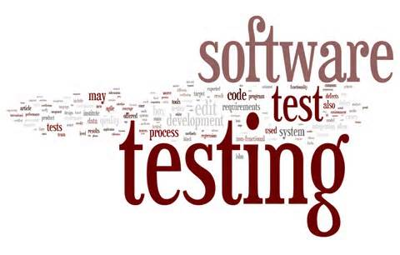
Module #10– Software regression testing
Software Testing
Topic #1 – Software Regression Testing
Instructor: Jerry Gao, Ph.D., Professor
San Jose State University
Notes:
From this session, we start to Module #2 on Software Testing Fundamentals.
In this module, we cover the basics of software testing, including the following subjects:
Topic #1 - Software Problem Management
Topic #2 - Software Test Design
Topic #3 - Software Test Management

Slide 2
Module #10– Software regression testing
Software Testing
What is Software Regression Testing?
Why do we perform Regression Testing ?
Software Regression Strategy
Regression Testing Approaches
Class Firewall Concepts
Notes:
This is the first package in Module 3 for Software Testing Class. It provides an introduction to software white-box testing. It covers the following
What is white-box testing?
Why Is white-box testing important?
Who does white-box testing?
White-box testing focuses
White-box testing coverage

Slide 3
Module #10– Software Regression testing
Software Testing
What is software regression testing?
Definition: Regression testing is the execution of a set of
test cases on a program in order to ensure that its revision
does not produce unintended faults. It is a testing process that is done to find the regressions in the system after doing any changes in the product during software maintenance phase.
What are the major testing objective?
Retest changed components (or parts)
Check the affected parts (or components)

Slide 4
Module #10– Software regression testing
Software Testing
When do we need to perform Regression Testing ?
Change in the requirements and code is modified according to the requirements.
New feature is added to the software
Defect fixing
Performance issue fix
Regression Testing at different levels
Regression testing at the unit level
Re-integration
Regression testing at the function level
Regression testing at the system level

Slide 5
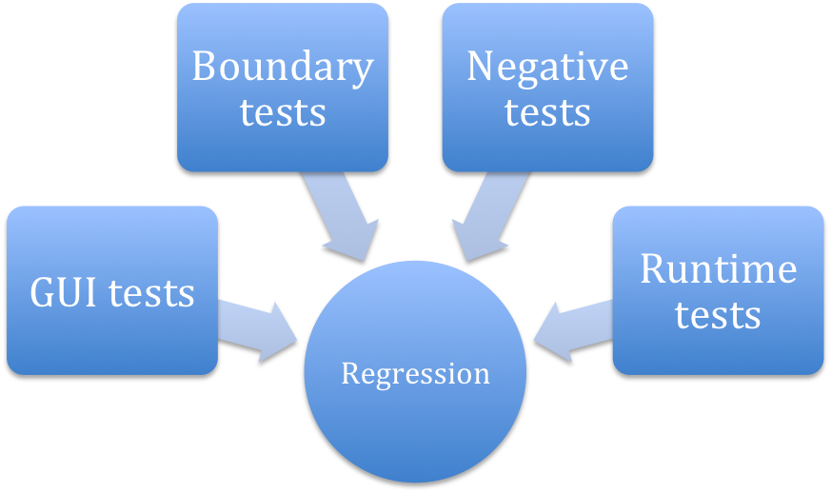
Module #10– Software Regression testing
Software Testing
Regression Testing Focuses
Notes:
White-box software testing focuses on the following areas:
– Program control/execution paths → to make sure that executable program control flows
can be correctly executed.
Program data → to make sure that program data parameters and values are properly set-up and
accessed.
– Program branches → to make sure that program branches are correctly implemented and exercised.
- Program logics → to make sure that the diverse program logics are correctly implemented and computed.

Slide 6
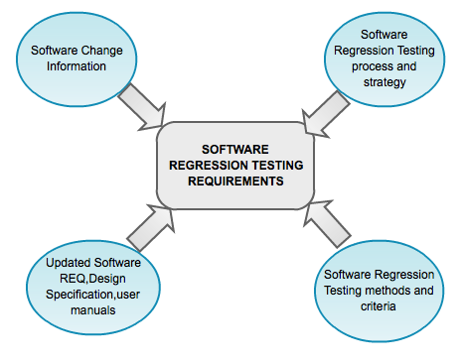
Module #10– Software regression testing
Software Testing
What do we need for Regression Testing
Who performs Regression Testing ?
Developers- regression testing at the unit level or integration
Test Engineers-regression testing at functional level
QA and Test Engineers- regression testing at the system level
Notes:
Why white-box software testing is important?
The major purpose is to achieve pre-defined program code coverage for white-box testing. Here are the typical objectives and reasons:
– Cover different program control flows and execution paths
Cover different program data and their value set-up and usage
Cover various program branches and logics
Uncover the deadlock program codes and cases in software

Slide 7
Module #10– Software regression testing
Software Testing
Problems and Challenges in Software Regression Testing
Major problems in software regression testing: How to identify software changes in a systematic way? - REQ. specification changes - Design specification changes - Implementation (or source code) changes - User manual changes - Environment or technology changes - Test changes How to identify software change impacts in a systematic way? - REQ impacts - Design impacts - Implementation impacts - User impacts - Test impacts
Notes:
White-box software testing focuses on the following areas:
– Program control/execution paths → to make sure that executable program control flows
can be correctly executed.
Program data → to make sure that program data parameters and values are properly set-up and
accessed.
-

Slide 8
Module #10– Software regression testing
Software Testing
Problems and Challenges in Software Regression Testing
Major problems in software regression testing: Major regression testing problems: - How to use a systematic method or tool to identify changed software parts? - How to use a systematic method or tool to identify software change impacts? - How to use a systematic method or tool to identify affected software test cases? - How to reduce the re-test suites? - How to select the test cases in a test suite? Major challenge in software regression testing: - How to minimize re-testing efforts, and achieve the adequate testing coverage ?
Notes:
White-box software testing focuses on the following areas:
– Program control/execution paths → to make sure that executable program control flows
can be correctly executed.
Program data → to make sure that program data parameters and values are properly set-up and
accessed.
-

Slide 9
Module #10– Software regression testing
Software Testing
Software Regression Strategy
What is software regression strategy ?
Software test strategy provides the basic strategy and guidelines to test engineers to perform software regression testing activities in a rational way. Software Regression strategy usually refers to --> a rational way to define regression testing scope, coverage criteria, re-testing sequence (or order) and re-integration orders. Software regression test models are needed to support the definition of software regression test strategy, test cases, and coverage criteria.
Notes:
White-box software testing focuses on the following areas:
– Program control/execution paths → to make sure that executable program control flows
can be correctly executed.
Program data → to make sure that program data parameters and values are properly set-up and
accessed.
-

Slide 10
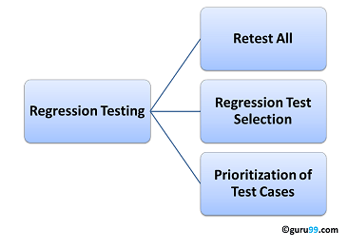
Module #10– Software Regression testing
Software Testing
Regression Testing Strategy
Reset all
This is one of the methods for regression testing in which all the tests in the existing test bucket or suite should be re-executed.
This is very expensive as it requires huge time and resources.
Jerry Gao Ph.D.
Notes:
White-box software testing focuses on the following areas:
– Program control/execution paths → to make sure that executable program control flows
can be correctly executed.
Program data → to make sure that program data parameters and values are properly set-up and
accessed.
-

Slide 11
Module #10– Software Regression testing
Software Testing
Regression Testing Strategy
2) Regression Test Selection
Instead of re-executing the entire test suite, it is better to select part of test suite to be run.
Test cases selected can be categorized as 1) Reusable Test Cases 2) Obsolete Test Cases.
Re-usable Test cases can be used in succeeding regression cycles.
Obsolete Test Cases can’t be used in succeeding cycles
3) Prioritization of Test Cases
Prioritize the test cases depending on business impact, critical & frequently used functionalities .
Selection of test cases based on priority will greatly reduce the regression test suite.
Jerry Gao Ph.D.
Notes:
White-box software testing focuses on the following areas:
– Program control/execution paths → to make sure that executable program control flows
can be correctly executed.
Program data → to make sure that program data parameters and values are properly set-up and
accessed.
-

Slide 12
Module #10– Software Regression testing
Software Testing
Regression Test Models
control flow graph, state-based behavior diagram
object-oriented class diagram
scenario-based model
component-based Regression model
Jerry Gao Ph.D.
Notes:
White-box software testing focuses on the following areas:
– Program control/execution paths → to make sure that executable program control flows
can be correctly executed.
Program data → to make sure that program data parameters and values are properly set-up and
accessed.
-

Slide 13
Module #10– Software Regression testing
Software Testing
Areas to focus on regression testing
Test cases which have frequent defects.
Functionalities which are more visible to the users.
Test cases which verify core features of the product.
Test cases of Functionalities which has undergone more and recent changes.
All Integration Test Cases.
All Complex Test Cases.
Boundary value test cases.
Sample of Successful test cases.
Sample of Failure test cases
Jerry Gao Ph.D.
Notes:
White-box software testing focuses on the following areas:
– Program control/execution paths → to make sure that executable program control flows
can be correctly executed.
Program data → to make sure that program data parameters and values are properly set-up and
accessed.
-

Slide 14
Module #10– Software regression testing
Software Testing
Software Regression Process
Step #1: Software Change Analysis - Understand and analyze various software changes. Step #2: Software Change Impact Analysis - Understand and analyze software change impacts Step #3: Define Regression Test Strategy and Criteria Step #4: Define, select, and reuse test cases to form a regression test suite Step #5: Perform re-testing at the different levels. - re-testing at the unit level - re-testing at integration level - re-testing at the function level - re-testing at the system level Step #6: Report and analyze regression test results
Jerry Gao Ph.D.
Notes:
White-box software testing focuses on the following areas:
– Program control/execution paths → to make sure that executable program control flows
can be correctly executed.
Program data → to make sure that program data parameters and values are properly set-up and
accessed.
-

Slide 15
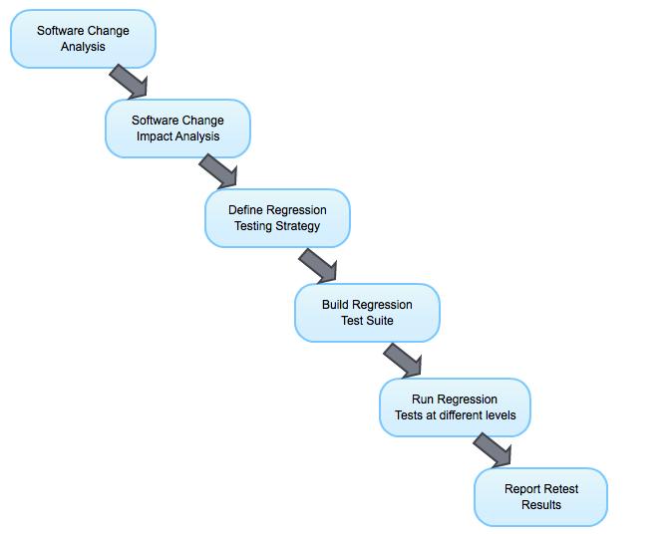
Module #10– Software regression testing
Software Testing
Software Regression Process
Jerry Gao Ph.D.
Notes:
White-box software testing focuses on the following areas:
– Program control/execution paths → to make sure that executable program control flows
can be correctly executed.
Program data → to make sure that program data parameters and values are properly set-up and
accessed.
-

Slide 16
Module #10– Software regression testing
Software Testing
Different Types of Software Changes
Requirements analysis Requirements Spec. Changes -> add new functional features -> change current function features -> delete existing function features System Design System architecture changes -> change component interactions -> add new components/subsystems -> update existing components -> delete existing components High-level design doc. Changes -> change state-based behaviors -> change component interfaces -> change database design -> change GUI design -> change function design
Jerry Gao Ph.D.
Notes:
White-box software testing focuses on the following areas:
– Program control/execution paths → to make sure that executable program control flows
can be correctly executed.
Program data → to make sure that program data parameters and values are properly set-up and
accessed.
-

Slide 17
Module #10– Software regression testing
Software Testing
Different Types of Software Changes
System Design Changes - Low-level design doc. Changes -> change algorithm logic
-> change component structure
System implementation - Component changes - internal data types and names - internal structures, such as
--> class relationships
--> control flow and data flow
- internal functions
- Component interface changes
- call signatures
- message interactions
- protocol messages and formats
- Technology and/or language changes
Jerry Gao Ph.D.
Notes:
White-box software testing focuses on the following areas:
– Program control/execution paths → to make sure that executable program control flows
can be correctly executed.
Program data → to make sure that program data parameters and values are properly set-up and
accessed.
-

Slide 18
Module #10– Software regression testing
Software Testing
Software Changes Impact
Types of system changes Types of product impacts Requirements changes Affect design, coding, and testing Document update Design changes Affect coding and tests Affect associated components Affect system architecture Affect related component interactions Implementation changes Affect test cases, test data, test scripts Affect test specification. Code change impact s - Test changes Affect other tests. Affect test documentation Document changes Affect other documents.
Notes:
White-box software testing focuses on the following areas:
– Program control/execution paths → to make sure that executable program control flows
can be correctly executed.
Program data → to make sure that program data parameters and values are properly set-up and
accessed.
-

Slide 19
Module #10– Software regression testing
Software Testing
Topic #2 – Software Regression Testing Strategies
Instructor: Jerry Gao, Ph.D., Professor
San Jose State University
Notes:
From this session, we start to Module #2 on Software Testing Fundamentals.
In this module, we cover the basics of software testing, including the following subjects:
Topic #1 - Software Problem Management
Topic #2 - Software Test Design
Topic #3 - Software Test Management

Slide 20
Module #10– Software regression testing
Software Testing
Traditional Software Regression Strategy Based on
The Firewall Concept
A Module-Based Firewall Concept for Software Regression Testing: A module firewall in a program refers to a changed software module and a closure of all possible affected modules and related integration links in a program based on a control-flow graph. With this firewall concept, we can reduce the software regression testing to a smaller scope --> All modules and related integration links inside the firewall. This implies that: - re-test of the changed module and its affected modules - re-integration for all of related integration links Similarly, we can come out different kinds of firewalls based on various test models. - data firewall, function firewall - class firewall, state/transaction firewall
Notes:
White-box software testing focuses on the following areas:
– Program control/execution paths → to make sure that executable program control flows
can be correctly executed.
Program data → to make sure that program data parameters and values are properly set-up and
accessed.
-

Slide 21
Module #10– Software regression testing
Software Testing
A Changed Module Firewall for Regression Testing
Main
4
M1
M2
M3
3
Changed Module
M4
M5
M6
M7
1
2
A module firewall:
- M5, M1, and Main
Re-testing at the unit level: M5,
Re-integration:
2, 3, 4
M8
Notes:
White-box software testing focuses on the following areas:
– Program control/execution paths → to make sure that executable program control flows
can be correctly executed.
Program data → to make sure that program data parameters and values are properly set-up and
accessed.
-

Slide 22
Module #10– Software regression testing
Software Testing
Regression Testing for State-Based Behavior Changes
Main
7
9
8
M1
M2
M3
4
5
6
3
M4
M5
M6
M7
1
2
M8
Notes:
White-box software testing focuses on the following areas:
– Program control/execution paths → to make sure that executable program control flows
can be correctly executed.
Program data → to make sure that program data parameters and values are properly set-up and
accessed.
-

Slide 23
Module #10– Software regression testing
Software Testing
Object-Oriented Software Regression Strategy
An OO Software Regression Testing Strategy Based on the Class Firewall Concept: - Identify changed classes - Identify affected classes using the concept of Class Firewall - Apply the Class Test Order strategy to classes in a class firewall to perform class re-testing at the unit level - Use the Class Test Order to re-integrate classes together. - Select, reuse, and define test cases based on the class firewall and change information.
Notes:
White-box software testing focuses on the following areas:
– Program control/execution paths → to make sure that executable program control flows
can be correctly executed.
Program data → to make sure that program data parameters and values are properly set-up and
accessed.
-

Slide 24
Module #10– Software regression testing
Software Testing
The Class Firewall Concept
A class firewall concept in OO Software is very useful for OO regression testing. What is a class firewall? - A class firewall is a closure set of all classes that are directly or indirectly dependent on the changed class in an OO program. - The class firewall provides the safe scope of regression testing for an OO software after changing a class. - Similarly, we can apply to many changed classes. Class Firewall Application: - With this class firewall concept, we can narrow down the class regression testing scope, including unit re-testing, and re-integration. - Based on the class firewall and changed information, we can select, define, and reuse class test cases for regression testing.
Notes:
White-box software testing focuses on the following areas:
– Program control/execution paths → to make sure that executable program control flows
can be correctly executed.
Program data → to make sure that program data parameters and values are properly set-up and
accessed.
-

Slide 25
Module #10– Software regression testing
Software Testing
A Changed Class in An Class Relation Diagram
ButtonList
Sensor
AG
AG
AS
AS
AS
AS
Button
AS
Event
Scene
AS
AS
I
I
TextButton
ButtonState
World
AG
I
AS
AS
AS
I
Subject
Control
I
CanvasRep
Canvas
AS
AS
I
AS
AS
AS
MonoScene
InstructorItr
ControlState
AG
Notes:
White-box software testing focuses on the following areas:
– Program control/execution paths → to make sure that executable program control flows
can be correctly executed.
Program data → to make sure that program data parameters and values are properly set-up and
accessed.
-

Slide 26
Module #10– Software regression testing
Software Testing
A Class Firewall for an Object-Oriented Programs
ButtonList
Sensor
AG
AG
AS
AS
AS
AS
Button
AS
Event
Scene
AS
AS
I
I
TextButton
ButtonState
World
AG
I
AS
AS
AS
I
Subject
Control
I
CanvasRep
Canvas
AS
AS
I
AS
AS
AS
MonoScene
InstructorItr
ControlState
AG
Notes:
White-box software testing focuses on the following areas:
– Program control/execution paths → to make sure that executable program control flows
can be correctly executed.
Program data → to make sure that program data parameters and values are properly set-up and
accessed.
-

Slide 27
Module #10– Software regression testing
Software Testing
A Class Test Order for The Class Firewall
2
1
ButtonList
Sensor
AG
1.2
AG
1.1
AS
AS
AS
AS
Button
2.2
AS
Event
Scene
AS
AS
I
1.3
I
TextButton
ButtonState
1.4
World
AG
I
AS
AS
AS
I
I
Subject
3.2
Control
I
CanvasRep
Canvas
AS
AS
I
AS
AS
AS
2
MonoScene
InstructorItr
3
ControlState
3.1
AG
Notes:
White-box software testing focuses on the following areas:
– Program control/execution paths → to make sure that executable program control flows
can be correctly executed.
Program data → to make sure that program data parameters and values are properly set-up and
accessed.
-

